Slide 1
MATHEMATICAL COMPUTATIONS
SESSION 3

Slide 2
SESSION OVER VIEW
FORMULAS
INTRODUCTORY STATISTICAL FUNCTIONS
FUNCTIONS FOR PERSONAL FINANCE
PREPARING TO PRINT
CHAPTER PRACTICE
CHAPTER SCORED

Slide 3
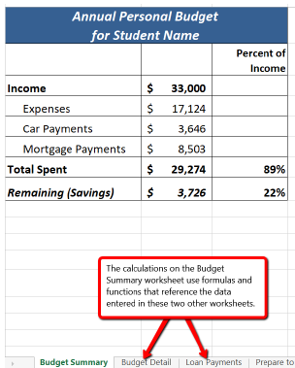
FORMULAS
This section reviews the fundamental skills for entering formulas into an Excel worksheet.
A formula starts with an equal sign (=).

Slide 4
FORMULAS
Creating a Basic Formula
Formulas are used to calculate a variety of mathematical outputs in Excel and can be used to create virtually any custom calculation required for your objective.
Furthermore, when constructing a formula in Excel, you use cell addresses that, when added to a formula, become cell references.
To Create a Formula:
1) Click in a cell
2) Press the = key
3) Type the formula
4) Press Enter

Slide 5
FORMULAS
1.Switch to the Budget Detail worksheet if needed. Click cell D3.
2. Type an equal sign = When the first character entered into a cell is an equal sign, it signals Excel to perform a
calculation.
3. Type B3. This adds B3 to the formula, which is now a cell reference. Excel will use whatever value is entered into cell
B3 in the calculation.
4. Type the * . This is the symbol for multiplication in Excel. As shown in Table 2.2 the mathematical operators in Excel
are slightly different from those found on a typical calculator.
5. Type the number 12. This multiplies the value in cell B3 by 12. In this formula, a number, or constant, is used instead of
a cell reference because it will not change. In other words, there will always be 12 months in a year.
6. Press the ENTER key. This enters the formula into the cell.

Slide 6
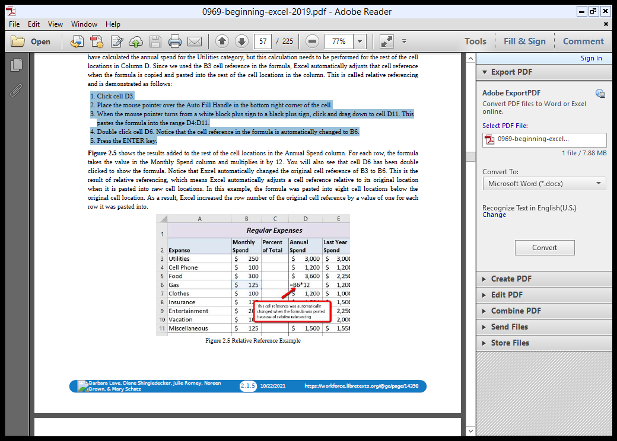
FORMULAS
Relative References (Copying and Pasting Formulas)
Once a formula is typed into a worksheet, it can be copied and pasted to other cell locations.
1. Click cell D3.
2. Place the mouse pointer over the Auto Fill Handle in the bottom right corner of the cell.
3. When the mouse pointer turns from a white block plus sign to a black plus sign, click and drag down to cell D11. This
pastes the formula into the range D4:D11.
4. Double click cell D6. Notice that the cell reference in the formula is automatically changed to B6.
5. Press the ENTER key.

Slide 7
FORMULAS
When writing complex formulas it is important to remember this order of operations.
You want to be sure that your formulas will calculate in the order you intend.
To help you remember which operations will be performed first, you can use the acronym PEMDAS.
P – parentheses
E – exponents
MD – multiplication and division
AS – addition and subtraction

Slide 8
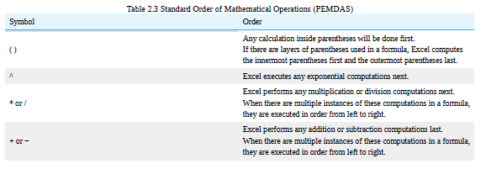
FORMULAS

Slide 9
FORMULAS
To create the Percent Change formula, we will need to use parentheses to control the order of the calculations.
We need the difference of the two values to be found before the division is done, so we will use parentheses around the subtraction portion of the formula to indicate that calculation needs to be done first.
This formula is added to the worksheet as follows:
1. Click cell F3 in the Budget Detail worksheet.
2. Type an equal sign =.
3. Type an open parenthesis (.

Slide 10
FORMULAS
4. Click cell D3. This will add a cell reference to cell D3 to the formula. When building formulas, you can click cell
locations instead of typing them.
5. Type a minus sign −.
6. Click cell E3 to add this cell reference to the formula.
7. Type a closing parenthesis ).
8. Type the slash / symbol for division.
9. Click cell E3. This completes the formula that will calculate the percent change of last year’s actual spent dollars vs. this year’s budgeted spend dollars (see Figure 2.6).

Slide 11
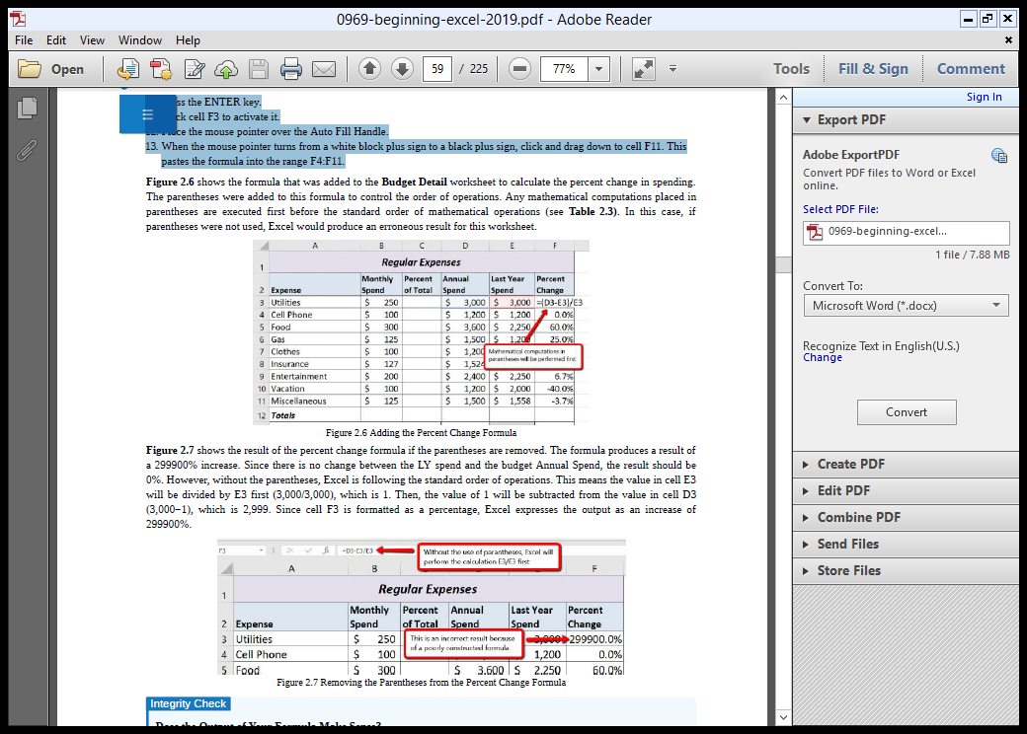
FORMULAS
10. Press the ENTER key.
11. Click cell F3 to activate it.
12. Place the mouse pointer over the Auto Fill Handle.
13. When the mouse pointer turns from a white block plus sign to a black plus sign, click and drag down to cell F11. This
pastes the formula into the range F4:F11.

Slide 12
FUNCTIONS IN FORMULAS
Excel comes with a variety of built-in formulas called Functions.
You can use a function alone in a formula or even a combination of more than 1 function with other operators and references.
Each function has its own syntax. The syntax consists of the name of the function plus any required or optional arguments, entered between brackets.
Most functions work on a range, where the range is a given number of respective cell references. E.g. A1:A6

Slide 13
FUNCTIONS IN FORMULAS
FUNCTION
SUM(arg1, arg2..)
MAX(arg1, arg2..)
MIN(arg1, arg2...)
COUNT(arg1,...)
AVERAGE(arg1,..)
USE
Add up total value of arguments. Cells with non-numeric data=Zero
Return the largest value (Maximum)
Return the Smallest value (Min)
Count the no. of numeric or date/time values in the arguments. Blanks & text are not counted.
Return the average of arguments.

Slide 14
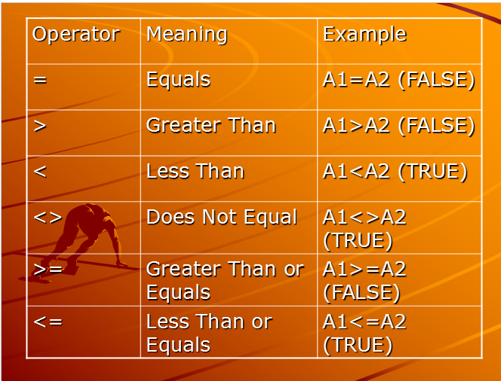
IF FUNCTION
The IF function is one of the most popular functions in Excel. It allows you to make logical comparisons between a value and what you expect. In its simplest form, the IF function says something like:
If the value in a cell is what you expect (true) – do this. If not – do that. Syntax: =IF(expression, true result, false result)
The expression must return a value that is either TRUE Or FALSE (Boolean).
The expressions are generally created using logical operators.
In the following example, let’s assume A1 contains 1 and A2 contains 2.

Slide 15
IF FUNCTION & ITS USE
Click the insert function button.
From the Category box, select Logical.
Select IF and ENTER
Click in the Logical text box and type AND(D11>0,E11>0). This argument uses the AND Function to check if both cells D11 & E11 contain a value greater than 0.
Click in the Value if true Box and type D11*E11.
In Value if false, type “” to show no value and ENTER
AutoFill the formula in the other cells.

Slide 16
INTERPRETING ERRORS
Sometimes a formula cannot return a result. Instead an error value is displayed like:
The Formula you typed contains an error: Means you typed the formula wrongly. Use the Function arguments box to check the syntax.
2. Circular reference: Means the cell containing the formula has also been entered as an argument.
3. #REF! – The cells referred to by the formula have been deleted. Hence change or delete the missing reference.

Slide 17
INTERPRETING ERRORS
4. ### - The cell is not wide enough to display the result. Increase it’s width.
5. #NAME? - Some text in the formula is not recognized. Check the spelling of function names and references. If using text, enclose it in quotes (“..”).
6. #VALUE? - One of the arguments is the wrong type of value. Check the values or references being used as arguments.

Slide 18
INTERPRETING ERRORS
7. #DIV/0 - The formula is attempting to divide by Zero. Check for an argument with a zero value and change or remove it.
8. #NUM! - One or more numeric arguments are invalid.
Note: (I) When a formula returns an error, an Error Options Smart Tag is displayed when you point at the cell. Click the smart tag to reveal options for dealing with the error.
(ii) If a formula depends on the result of another formula which returns an error, the first formula may also return an error.

Slide 19
KEY BOARD SHORTCUTS
CTRL+SHIFT+~ : General no. format
CTRL+SHIFT+$ : Currency Format
CTRL+SHIFT+% : Percent Style Format
CTRL+SHIFT+! : Comma Style Format
CTRL+SHIFT+# : Date Format
CTRL+SHIFT+@ : Time Format

Slide 20
USE AUTOSUM & STATUS BAR CALCULATIONS
AutoSum is a useful tool for creating column and row Totals.
You can select a range that you want to sum then click the AutoSum button to insert a SUM function formula. E2:E10 and on the Standard toolbar, click AutoSum, then D2:G13
Also, if you want to perform a calculation without inserting a formula, you can view basic function results on the STATUS BAR.

